Slide 1
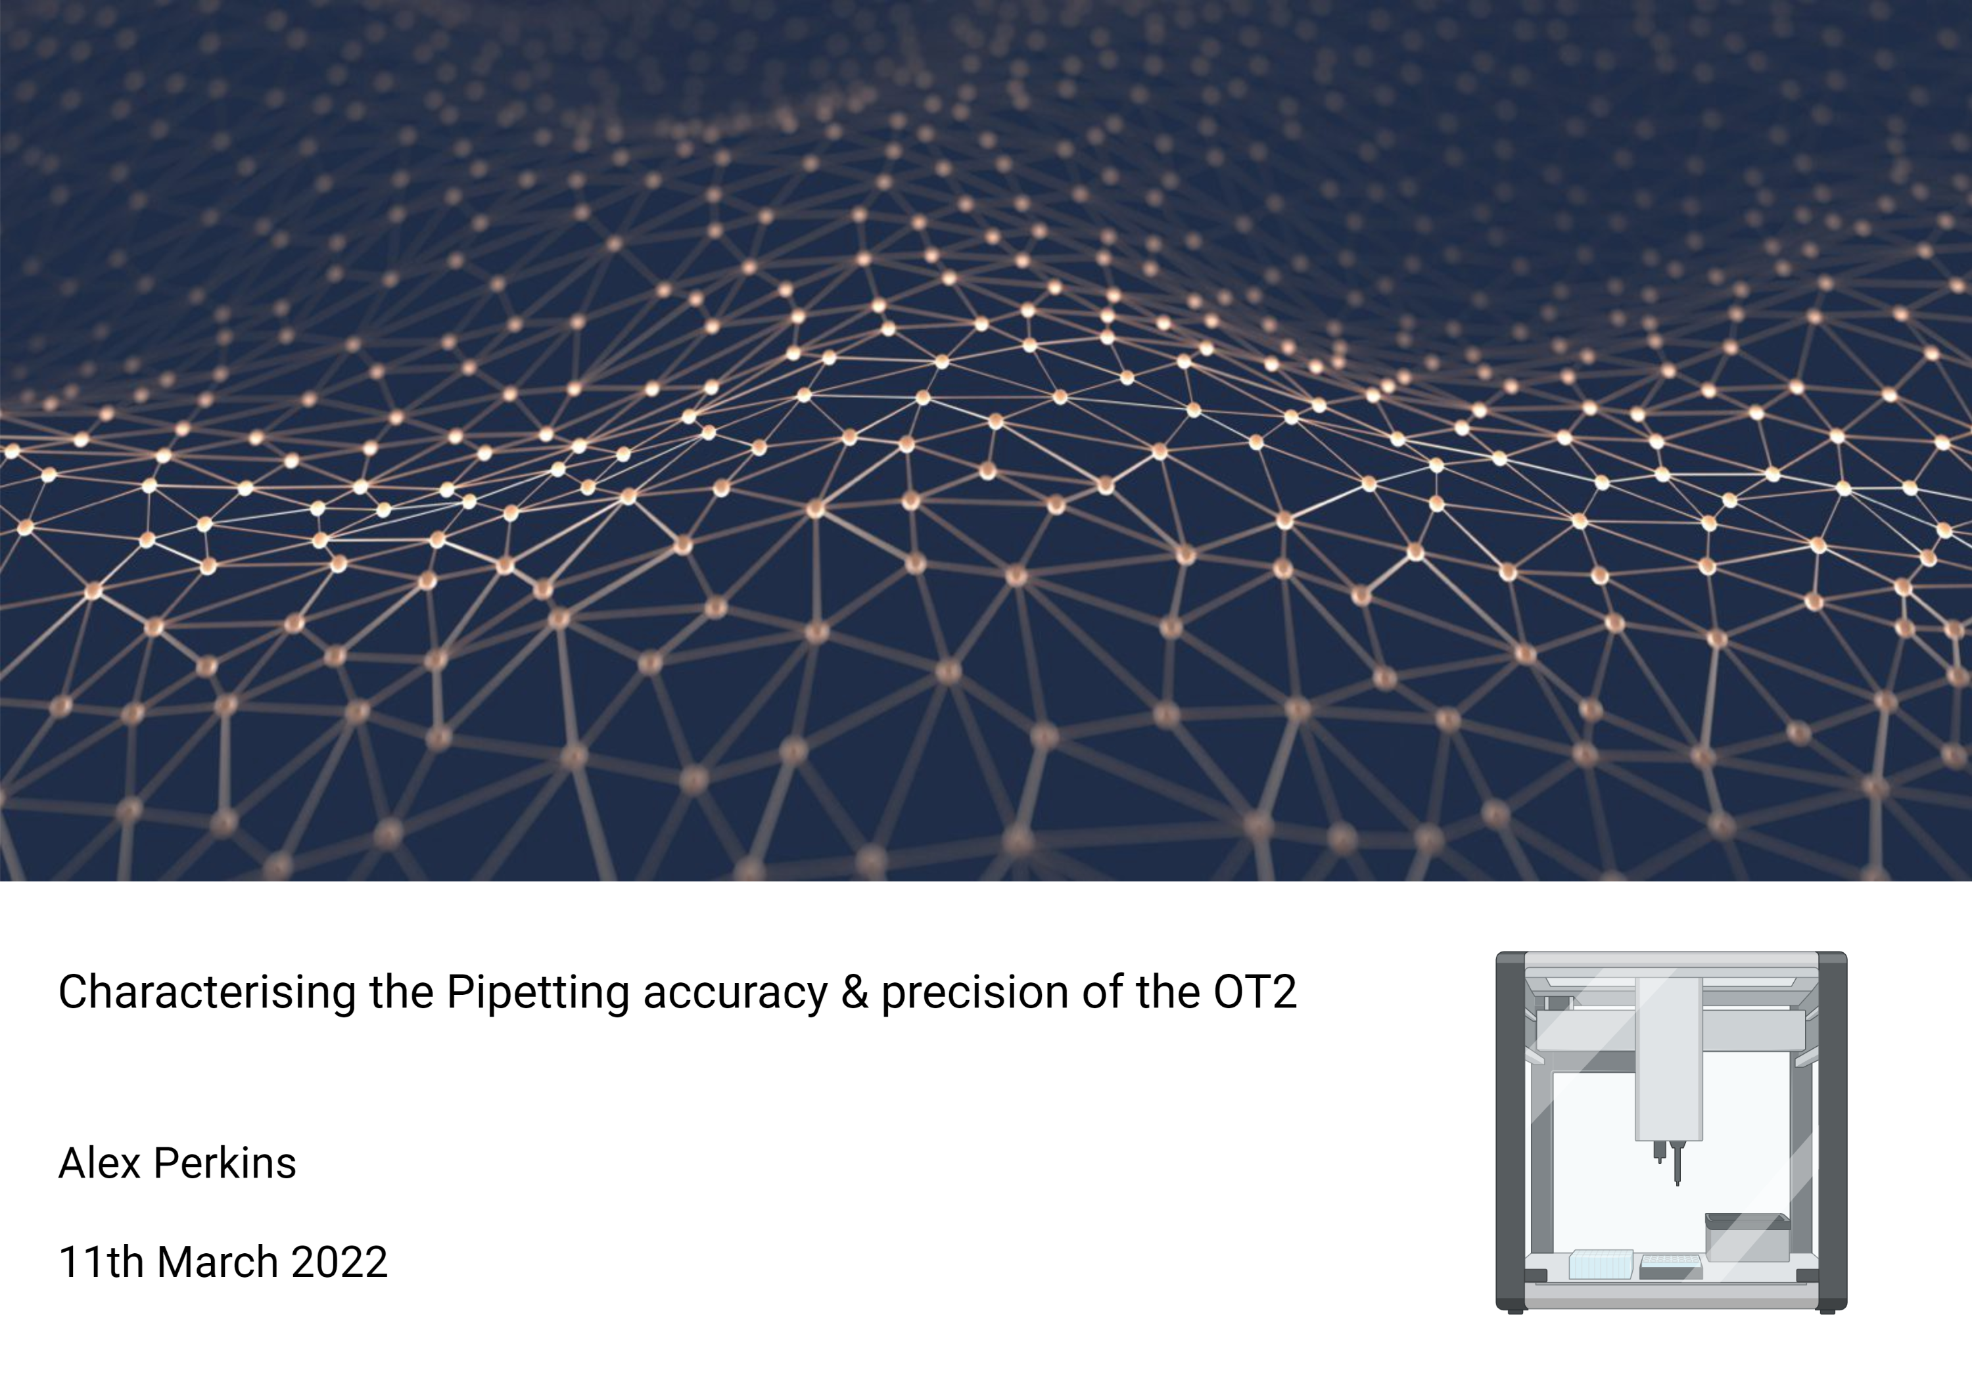

Slide 2
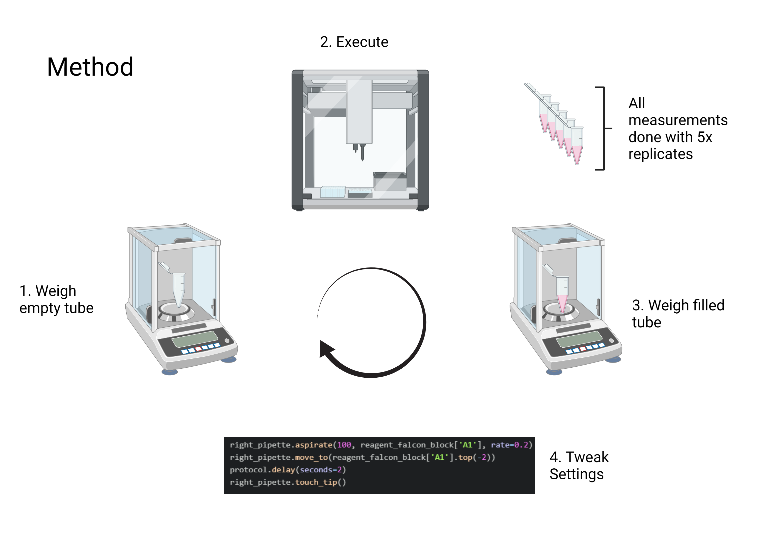

Slide 3
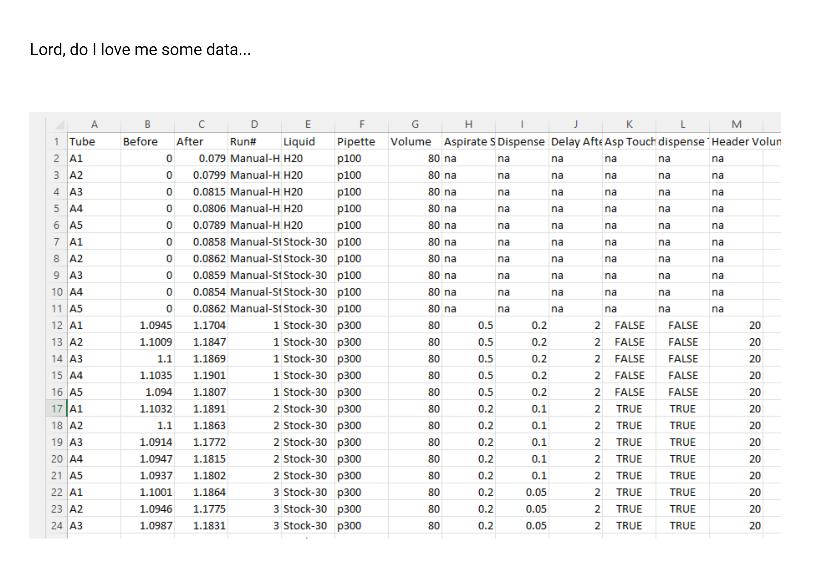

Slide 4
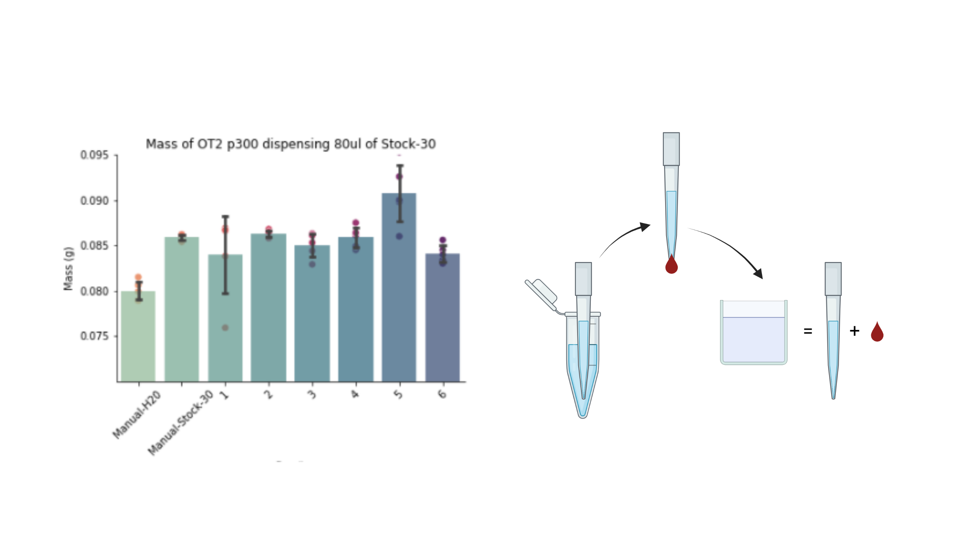

Slide 5
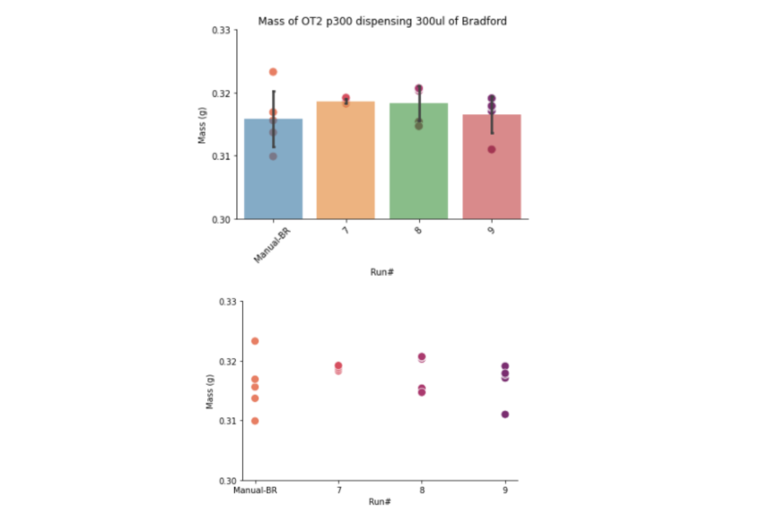

Slide 6
Summary:
Pipetting steps must be optimised for:
Liquid
Volume
Pipette
Aspiration and Dispensing Flow Rates & pipette submersion are most influential
TBC…

